Slide 1

Data analytics - project 2 USA Fast Food Restaurant Analysis
Matthew Kennedy, Natalie Myers, Myles Bridges, Sedra Kurdi

Slide 2
Dataset
This dataset is a list of 10,000 fast food restaurants located in the US (from December 2018 - May 2019)
Taken from Datafiniti's Business Database in CSV format
Data includes such information as:
City, zip code, latitude & longitude, name of restaurant, category, state, website URL, and ID

Slide 3
Goals
Import data into a SQL database and clean
Extract useful data – zip code, coordinates, name of fast food restaurant, and state
Create an API in flask to retrieve information from database and display in HTML formatted webpage
Utilize charts.js (JavaScript library) to create an interactive bar graph and pie graph of relevant data
Utilize mapbox through leaflet to display an interactive map of each state with markers and popups representing each restaurant

Slide 4
Process – ETL import and clean data with python in jupyter notebook

Slide 5
Process
Create flask environment that calls tables from PostgreSQL database
Convert to JSON object via Python dictionary

Slide 6
Process
Using charts.js library – create a bar & doughnut chart of top fast food chains per selected state
Also create a bar and doughnut chart of the zip codes with the most fast food restaurants within a selected state

Slide 7
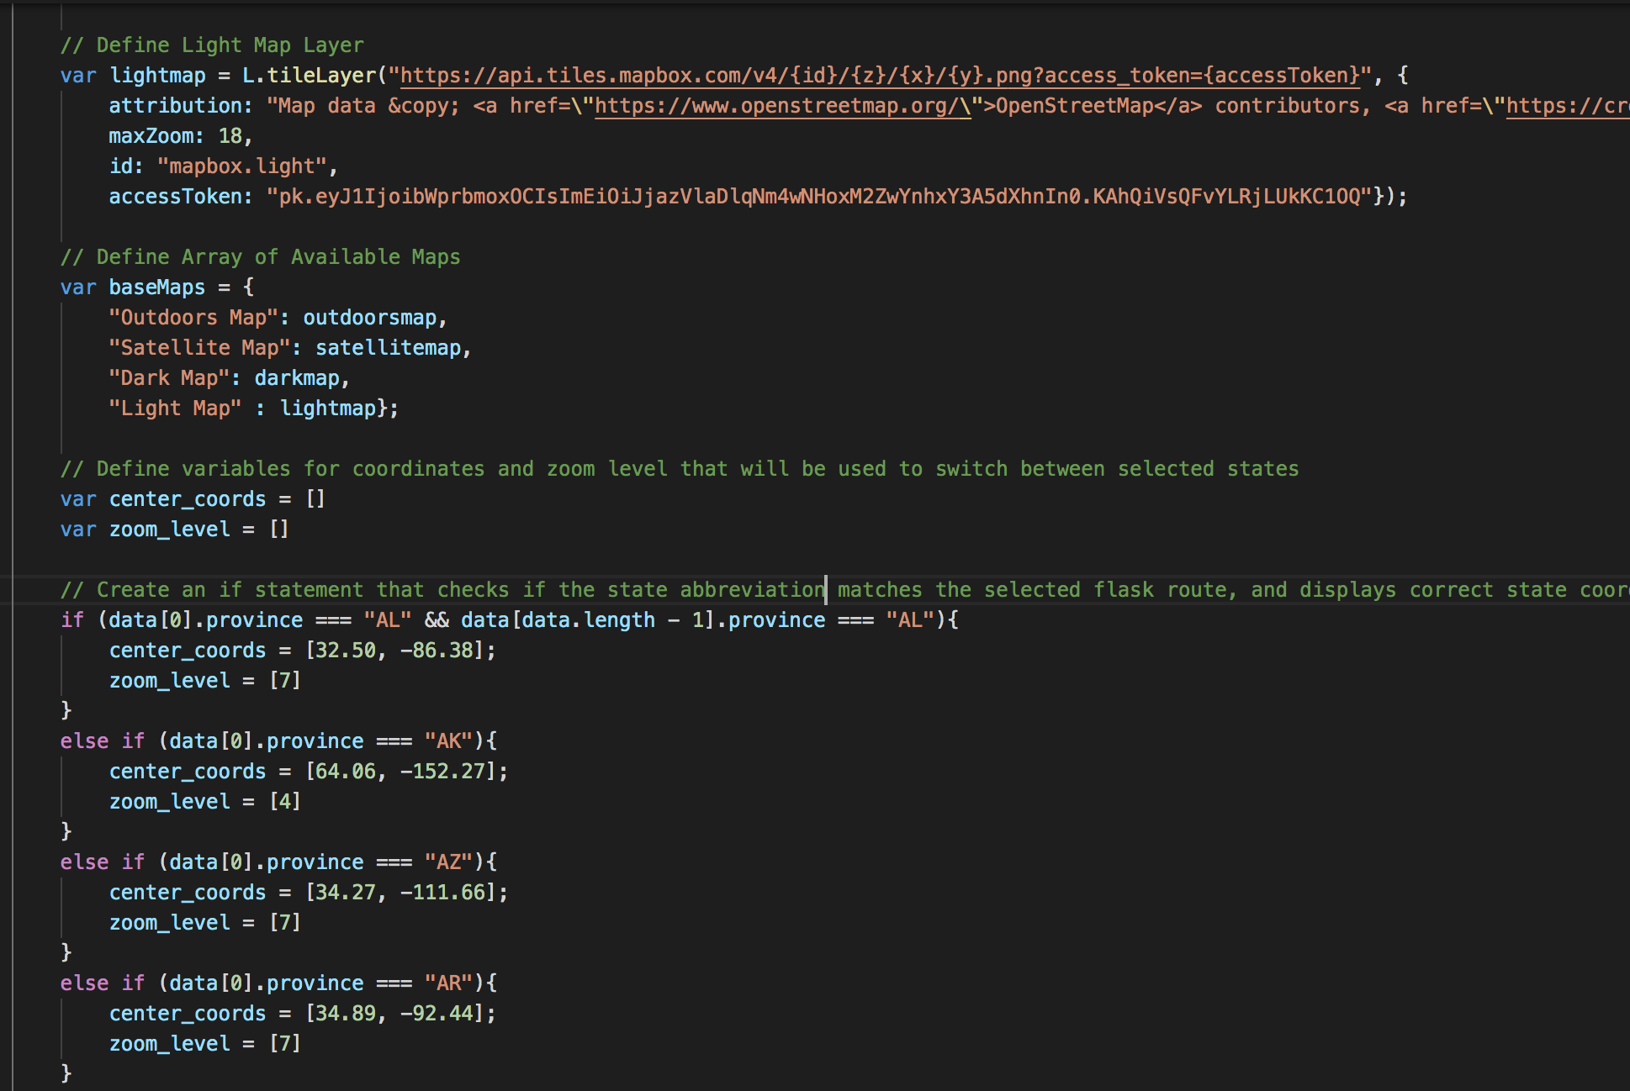
Process – with a mapbox api call use leaflet to display a view of fast food markers by state

Slide 8
Review of methods used
Python
Jupyter Notebook
SQL – PostgreSQL
VSCode
Flask
HTML
Leaflet
Chart.js

Slide 9
Dashboard demo

